Slide 1



PANGOLIN TEAM

Slide 2


Slide 3

TACKLED PROBLEM

Slide 4
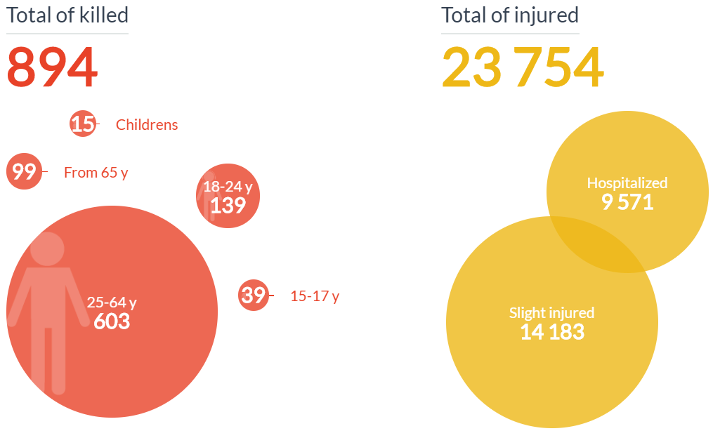
23 times more likely to crash than a motorist

Slide 5
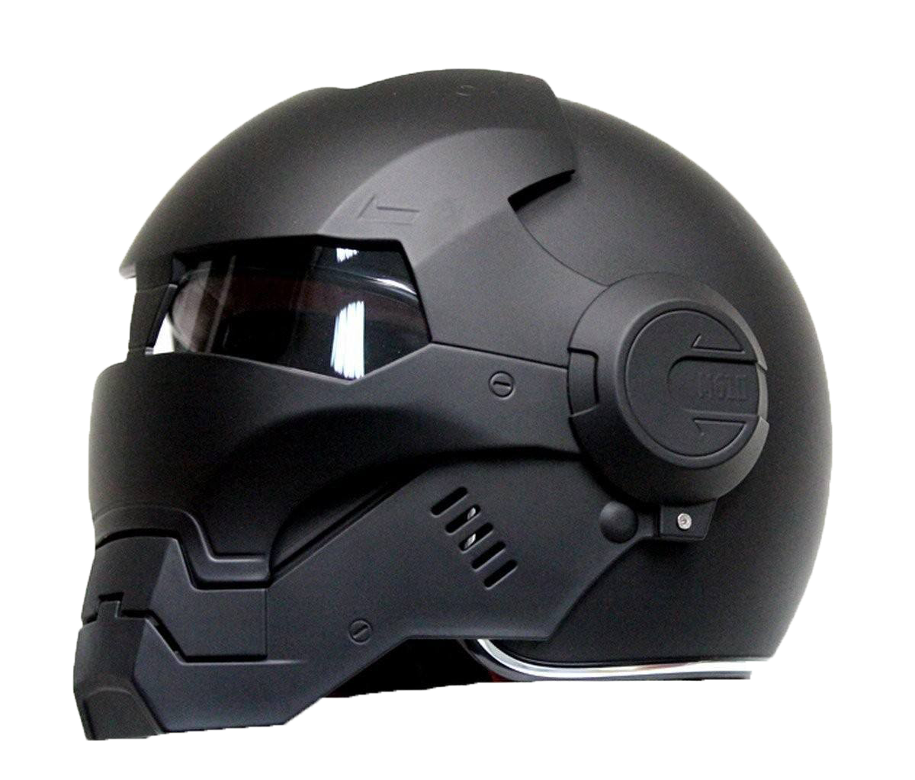
OUR SOLUTION
SIM card
Detector housing
Captors, sensors
Visor
Speakers
Micro

Slide 6
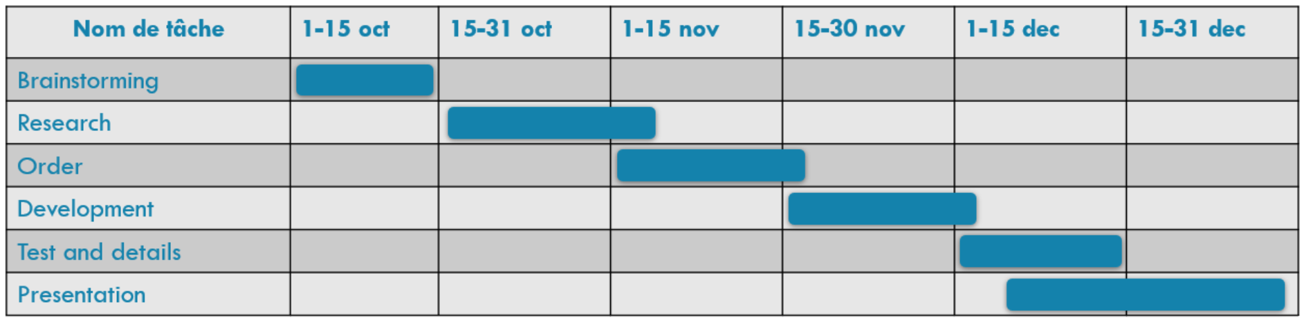
GANTT DIAGRAM

Slide 7
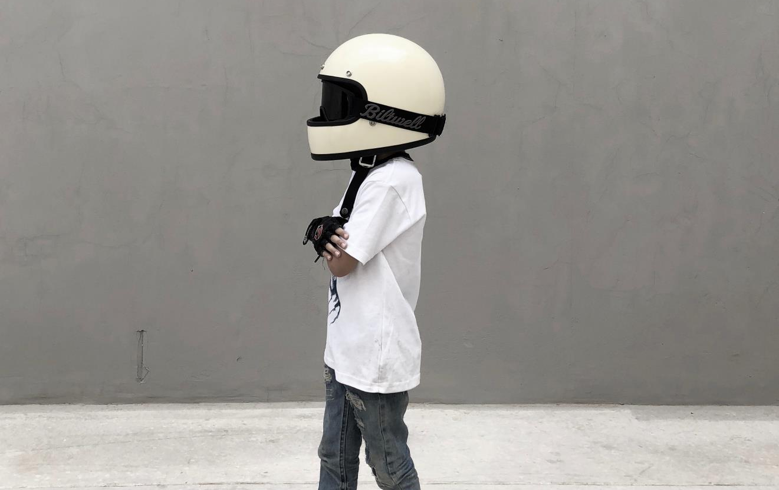
homologation
ECE 22-05 norm
vision angle
screen quality
impact deformation
restraint system
abrasion resistance
shock absorption
NORMS AND REGULATION

Slide 8

Pangolin team
Jean-François LE GAL
Arthur MAIGROT Tom CHEMALY Charlotte GEX

